Slide 1







STACK OVERFLOW DEVELOPER SURVEY 2019
Name: Walid Alakk
Date : 17-July-2024

Slide 2



OUTLINE
Executive Summary
Introduction
Methodology
Results
Visualization – Charts
Dashboard
Discussion
Findings & Implications
Conclusion
Appendix

Slide 3

EXECUTIVE SUMMARY
Point1: Overview of the survey and its importance
Point2: Key findings
Sub Point 1: Popular programming languages
Sub Point 2: Job satisfaction and career aspirations
Sub Point 3: Employment trends
Point3: Implications for developers and employers
Point4: Future technology trends
Point5: Demographic insights

Slide 4

INTRODUCTION
You have recently joined a global IT and business consulting services firm as a Data Analyst, known for its IT solutions and experienced consultants. To stay competitive with evolving technologies, your organization frequently analyzes data to forecast future skill requirements.
As part of this initiative, your role involves collecting data from various sources and identifying trends for this year's report on emerging skills. Your first task is to gather information on the top programming skills in demand from job postings, training portals, and surveys.
After collecting the data, you will analyze it to identify insights and trends, such as the most sought-after programming languages, database skills, and popular Integrated Development Environments (IDEs). This involves scraping websites and accessing APIs to gather data in formats like .csv files, Excel sheets, and databases.
Once data collection is complete, you will use data wrangling techniques to prepare it for analysis. Then, apply statistical methods to uncover trends and insights. Finally, you will use IBM Cognos Analytics to create a dashboard and present your findings in a compelling presentation.

Slide 5

METHODOLOGY
Collect survey data & explore its content
Web Scraping
APIs.
Request library.
Data Wrangling
Exploratory data analysis
Analyzing data distribution.
Handling outliers.
Correlations.
Data Visualization
Highlight distribution of data, relationships, the composition and comparison of data.
Dashboards

Slide 6
RESULTS

Slide 7
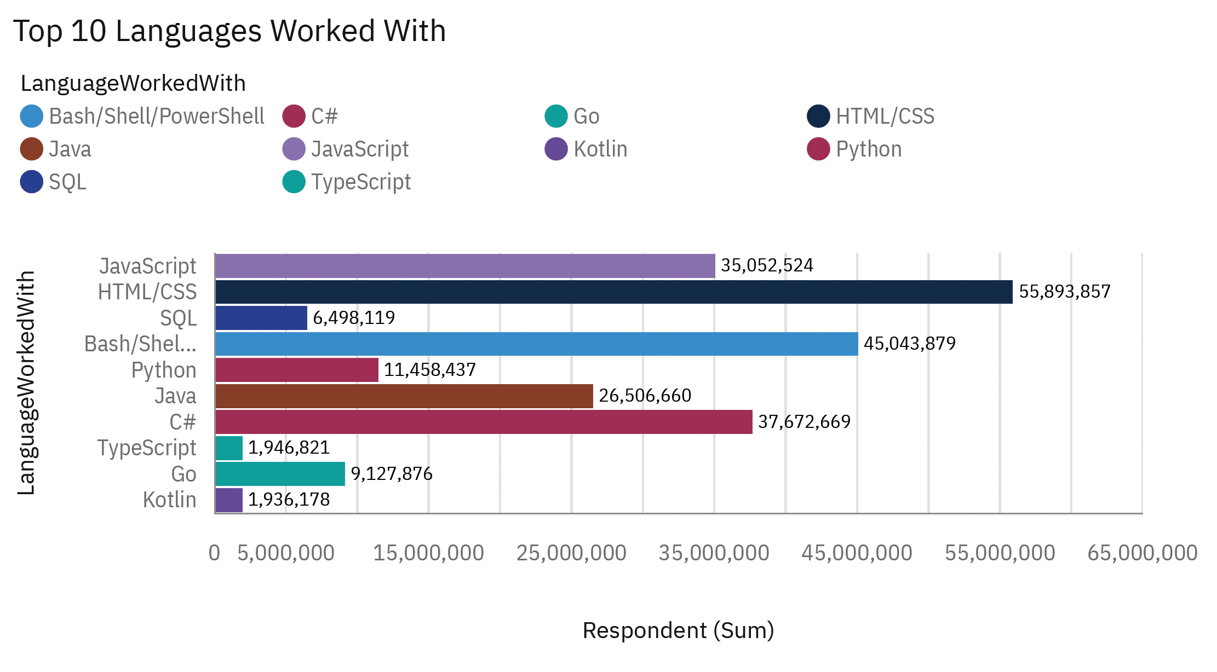
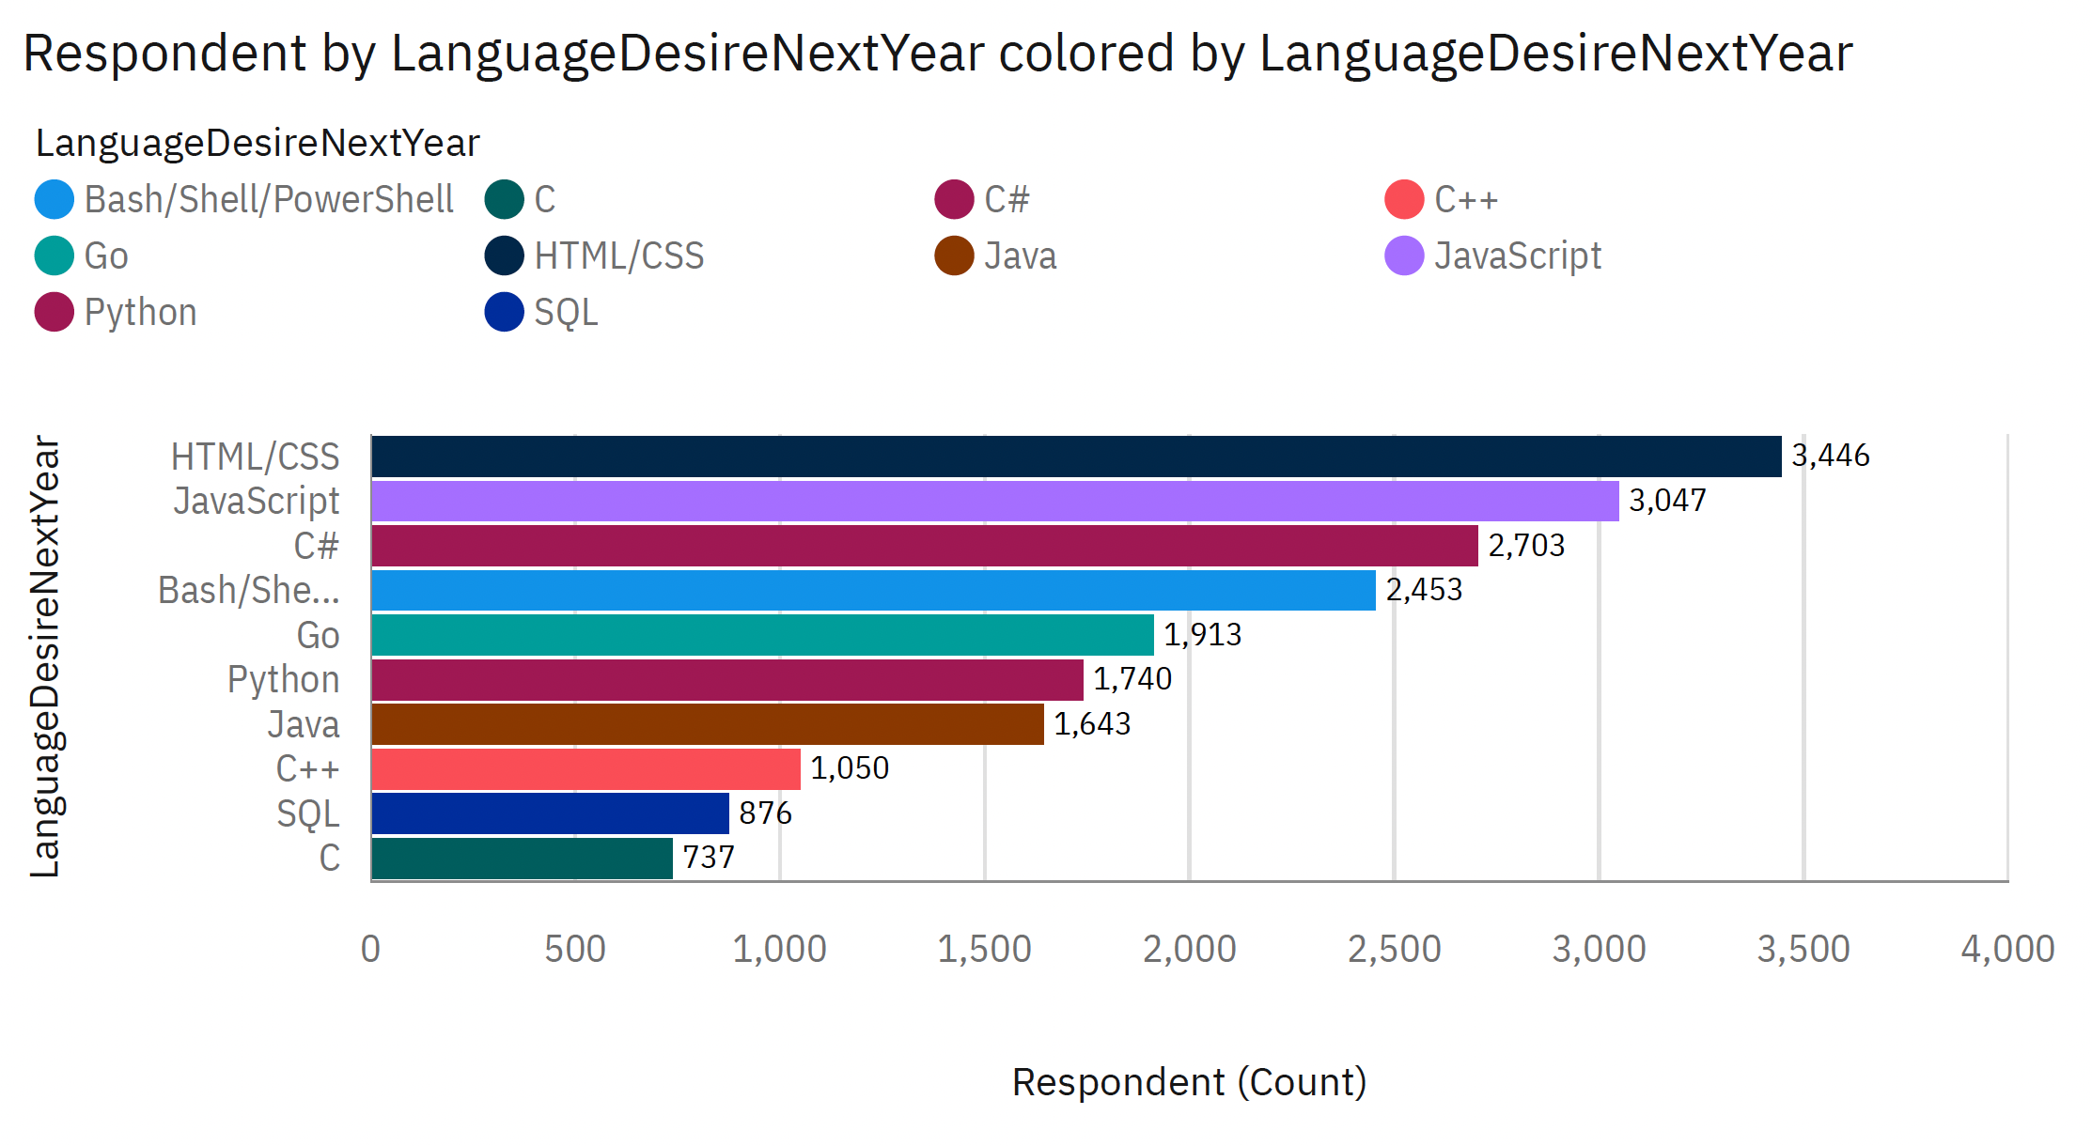
PROGRAMMING LANGUAGE TRENDS
Current Year
Next Year
Top 10 Languages Desired Next Year

Slide 8
PROGRAMMING LANGUAGE TRENDS - FINDINGS & IMPLICATIONS
Findings
Current Language Usage:
JavaScript is the most widely used language, followed by HTML/CSS and SQL.
Python and Java are also highly popular.
Future Language Trends:
HTML/CSS and JavaScript are the top languages respondents wish to learn next year.
Python remains highly desired, indicating its growing popularity.
Implications
For Developers:
Focus on improving skills in JavaScript, HTML/CSS, and SQL.
Invest time in learning Python and Go for future relevance.
For Employers:
Offer training programs for JavaScript, HTML/CSS, and Python.
Prioritize hiring developers skilled in these languages.
For Educators:
Develop curriculum and certifications emphasizing JavaScript, HTML/CSS, and Python.

Slide 9
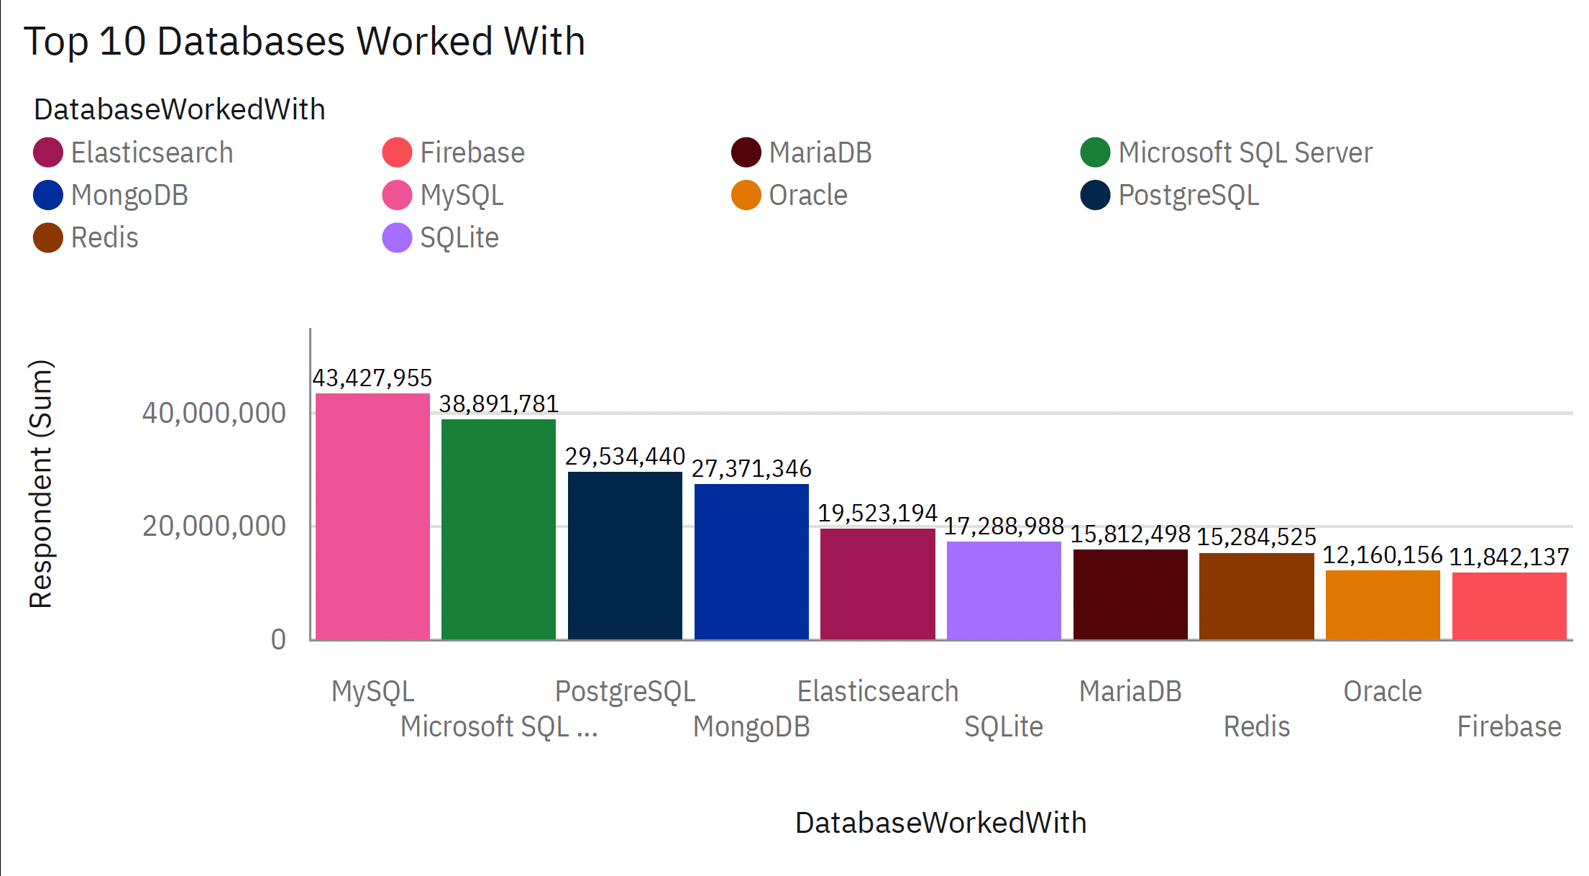
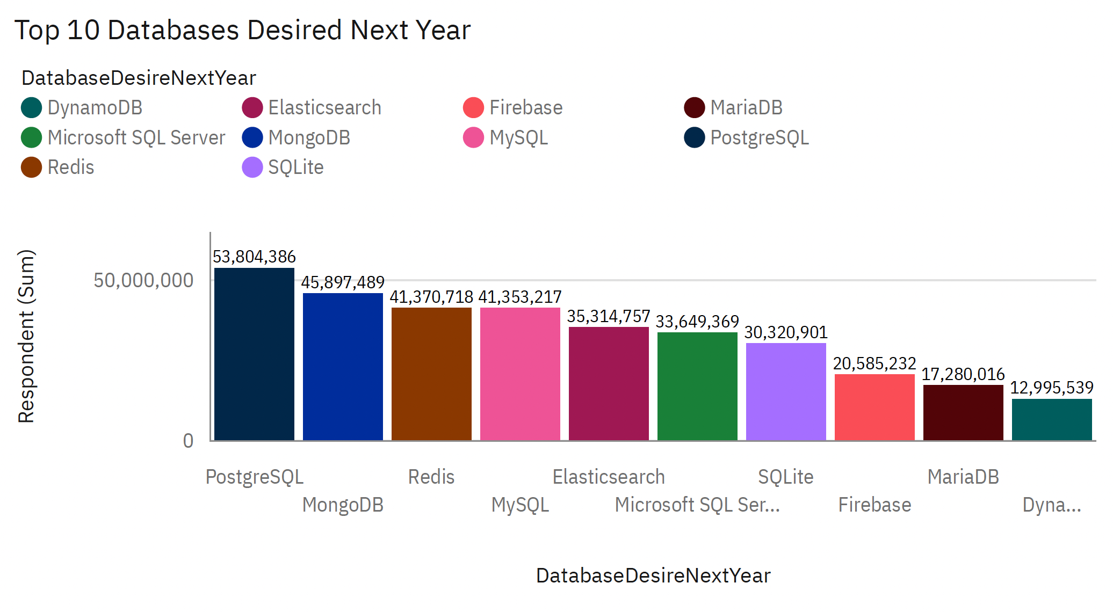
DATABASE TRENDS
Current Year
Next Year

Slide 10
DATABASE TRENDS - FINDINGS & IMPLICATIONS
Findings
Current Database Usage:
MySQL is the most widely used database, followed by Microsoft SQL Server and PostgreSQL.
MongoDB and Elasticsearch are also popular choices among developers.
Future Database Trends:
PostgreSQL is the top database respondents wish to learn next year.
MongoDB and Redis are highly desired for future learning, indicating their growing importance.
Implications
For Developers:
Focus on improving skills in MySQL, Microsoft SQL Server, and PostgreSQL.
Invest time in learning PostgreSQL, MongoDB, and Redis for future career opportunities.
For Employers:
Offer training programs for MySQL, Microsoft SQL Server, and PostgreSQL.
Prioritize hiring developers with skills in PostgreSQL, MongoDB, and Redis to stay ahead of the trend.
For Educators:
Develop curriculum and certifications emphasizing MySQL, Microsoft SQL Server, and PostgreSQL.
Include courses on PostgreSQL, MongoDB, and Redis to prepare students for future demands.

Slide 11

DASHBOARD
Github Link – IBM Cogno – Dashboard
https://github.com/Walid-Alakk/IBM-Data-Analyst-Capstone/blob/main/9-%20IBM%20Data%20Analyst%20Capstone%20Dashboard.pdf

Slide 12
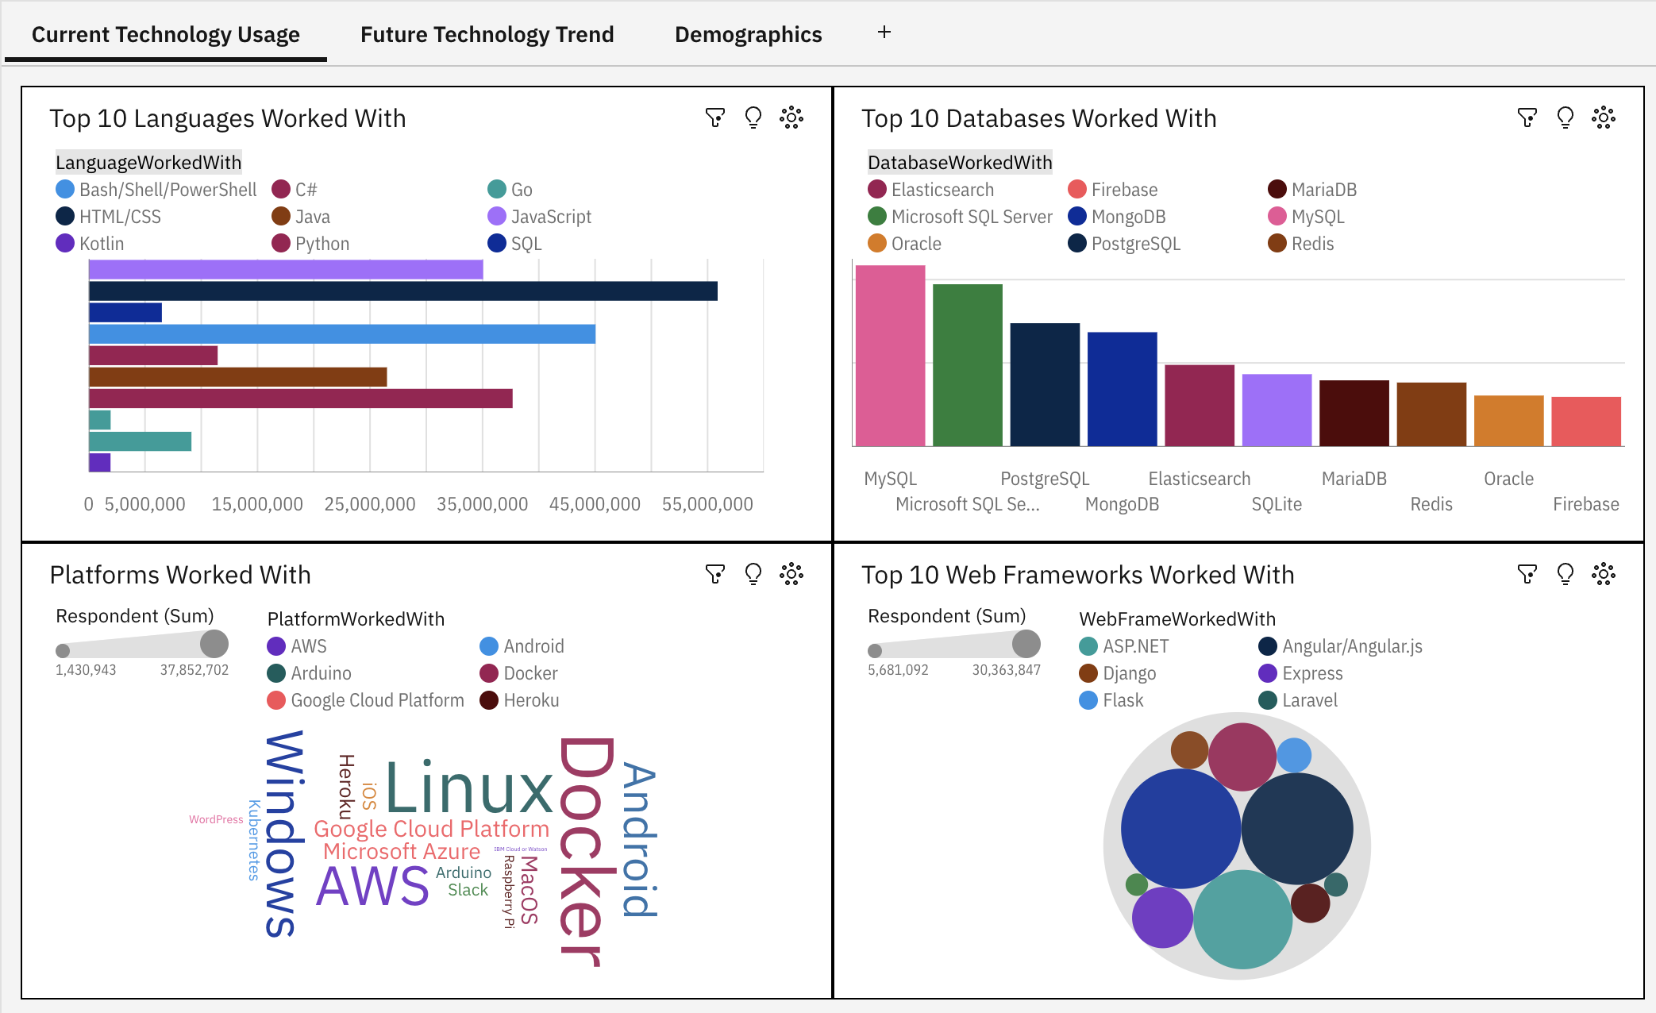
DASHBOARD TAB 1

Slide 13
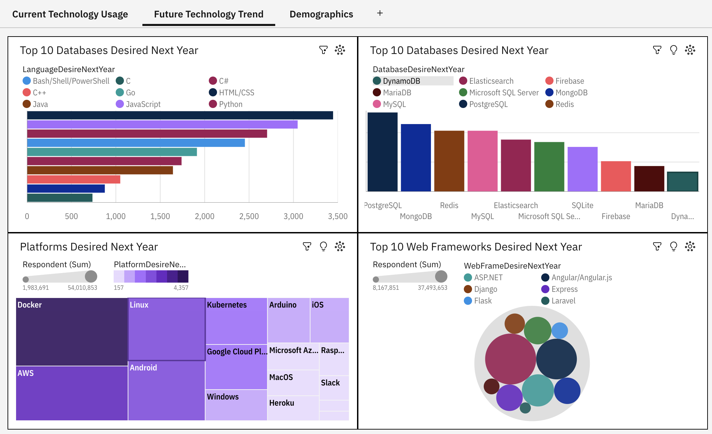
DASHBOARD TAB 2

Slide 14
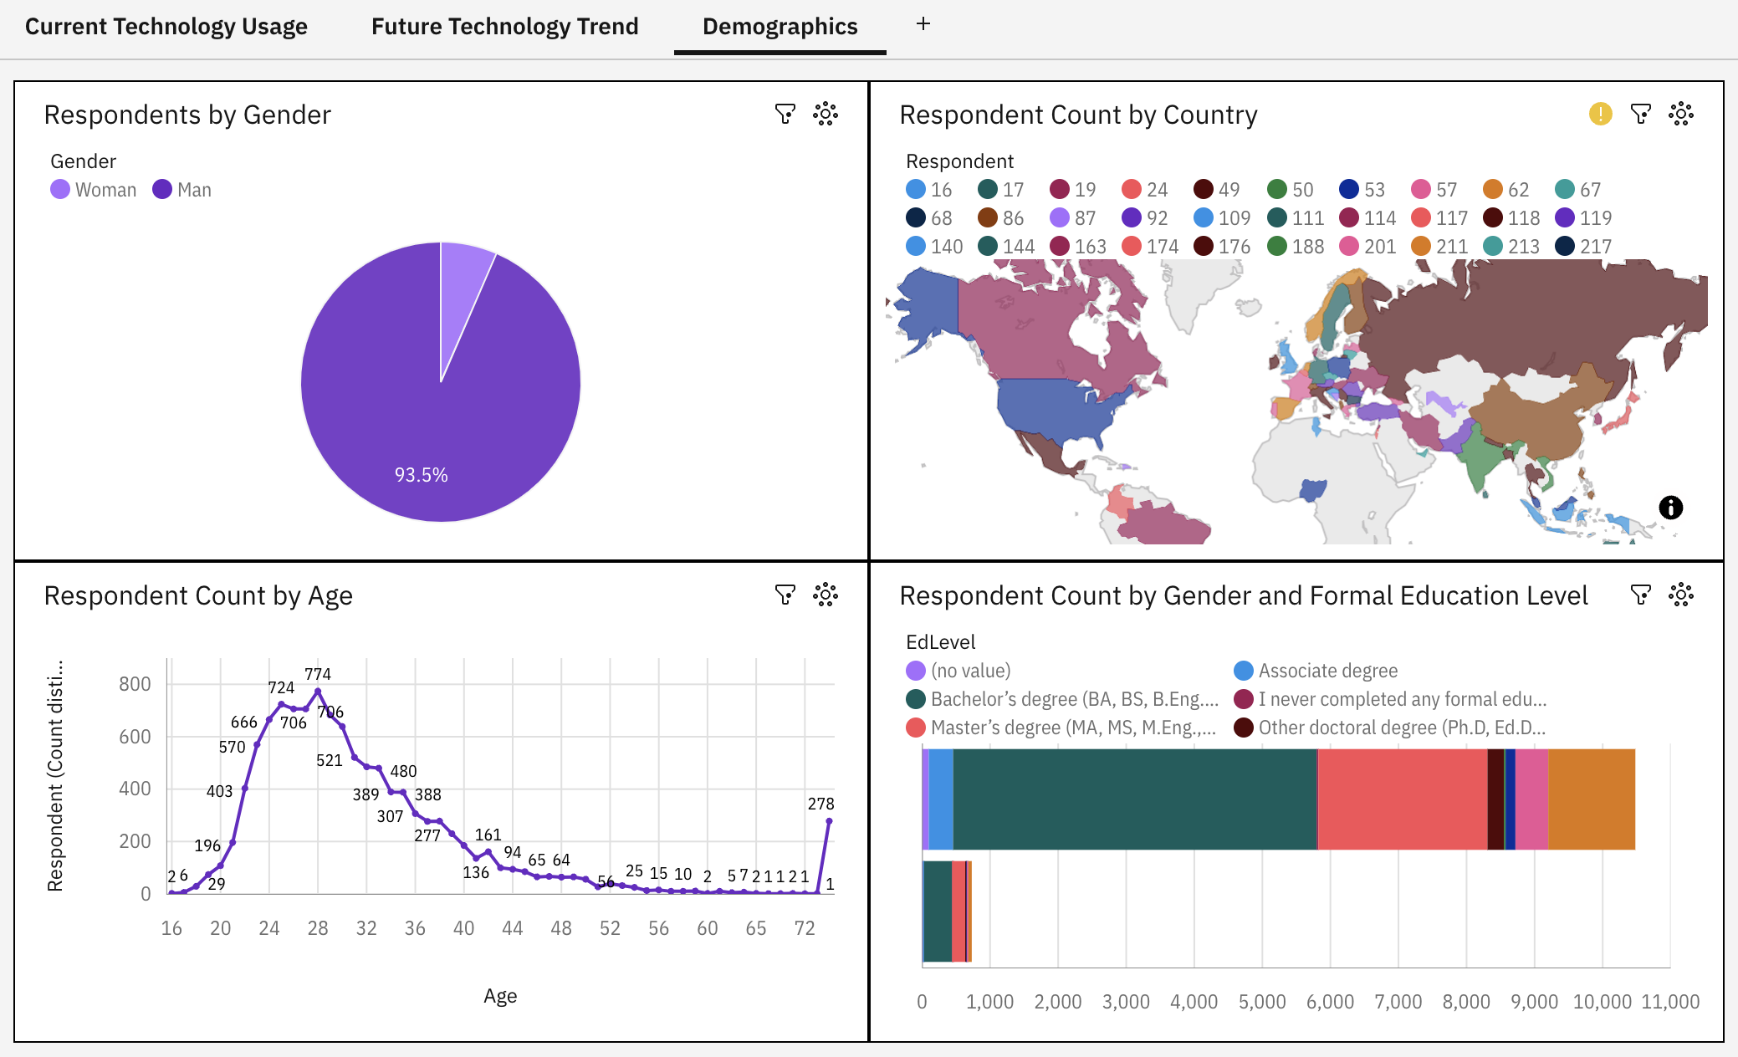
DASHBOARD TAB 3

Slide 15
DISCUSSION

Slide 16
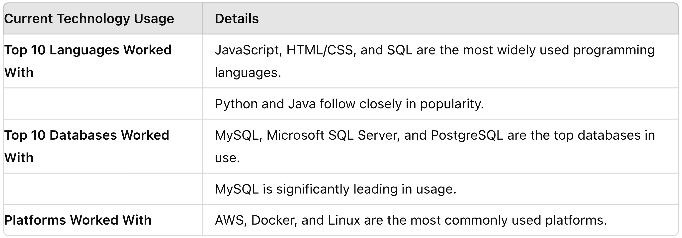
OVERALL FINDINGS & IMPLICATIONS
Findings

Slide 17
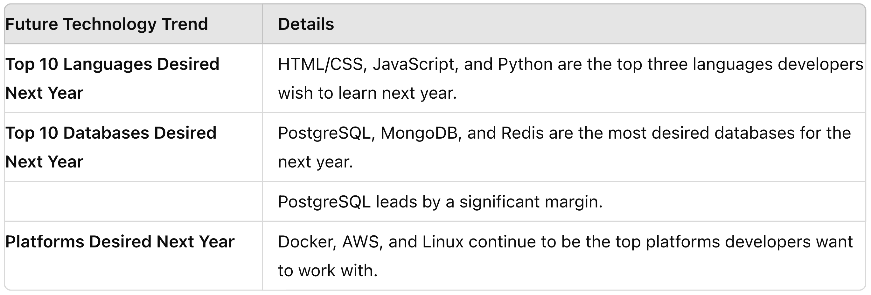
OVERALL FINDINGS & IMPLICATIONS
Findings

Slide 18
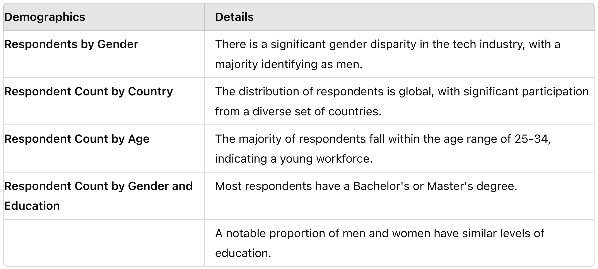
OVERALL FINDINGS & IMPLICATIONS
Findings

Slide 19
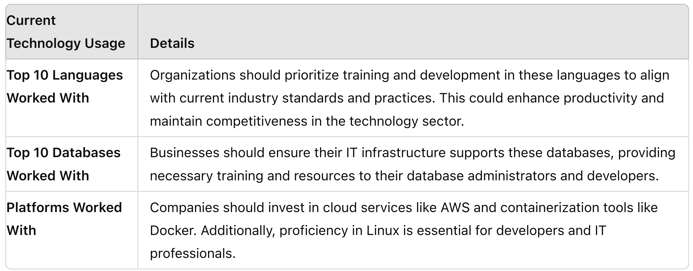
OVERALL FINDINGS & IMPLICATIONS
Implications

Slide 20
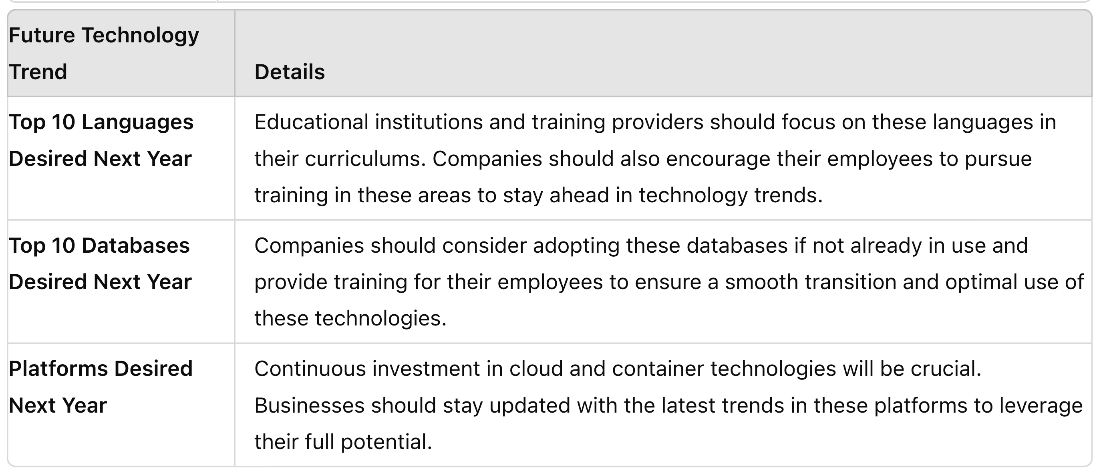
OVERALL FINDINGS & IMPLICATIONS
Implications

Slide 21
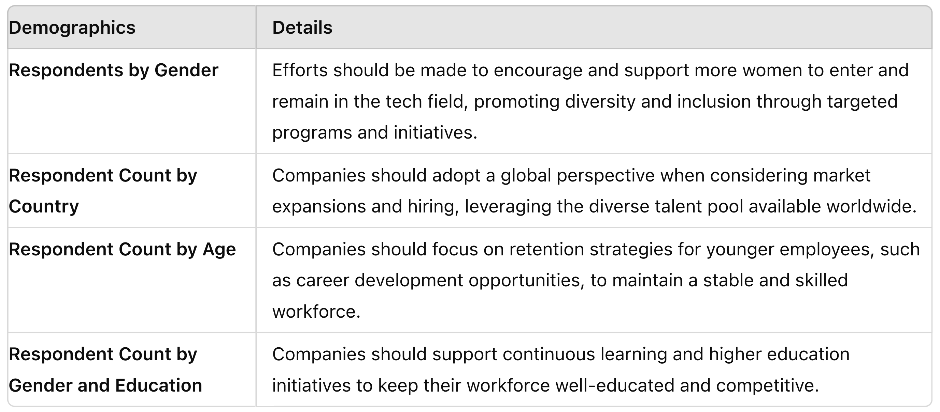
OVERALL FINDINGS & IMPLICATIONS
Implications

Slide 22

CONCLUSION
Recommendations:
For Businesses: Invest in training and development programs for the top languages and platforms. Adopt and support the most desired databases and platforms to ensure technological relevance and efficiency. Focus on diversity and inclusion initiatives to promote a balanced workforce.
For Educational Institutions: Align curriculums with the current and future technology trends identified in the survey. Provide specialized training in the most demanded languages and platforms to prepare students for the evolving tech landscape.
For Industry Stakeholders: Promote initiatives that support continuous learning and professional development. Encourage diversity in the tech industry to harness a wide range of perspectives and innovations.
By understanding and acting on these insights, stakeholders can make informed decisions that align with industry trends, promote technological advancement, and support a diverse and skilled workforce.

Slide 23

APPENDIX
Include any relevant additional charts, or tables that you may have created during the analysis phase.

Slide 24
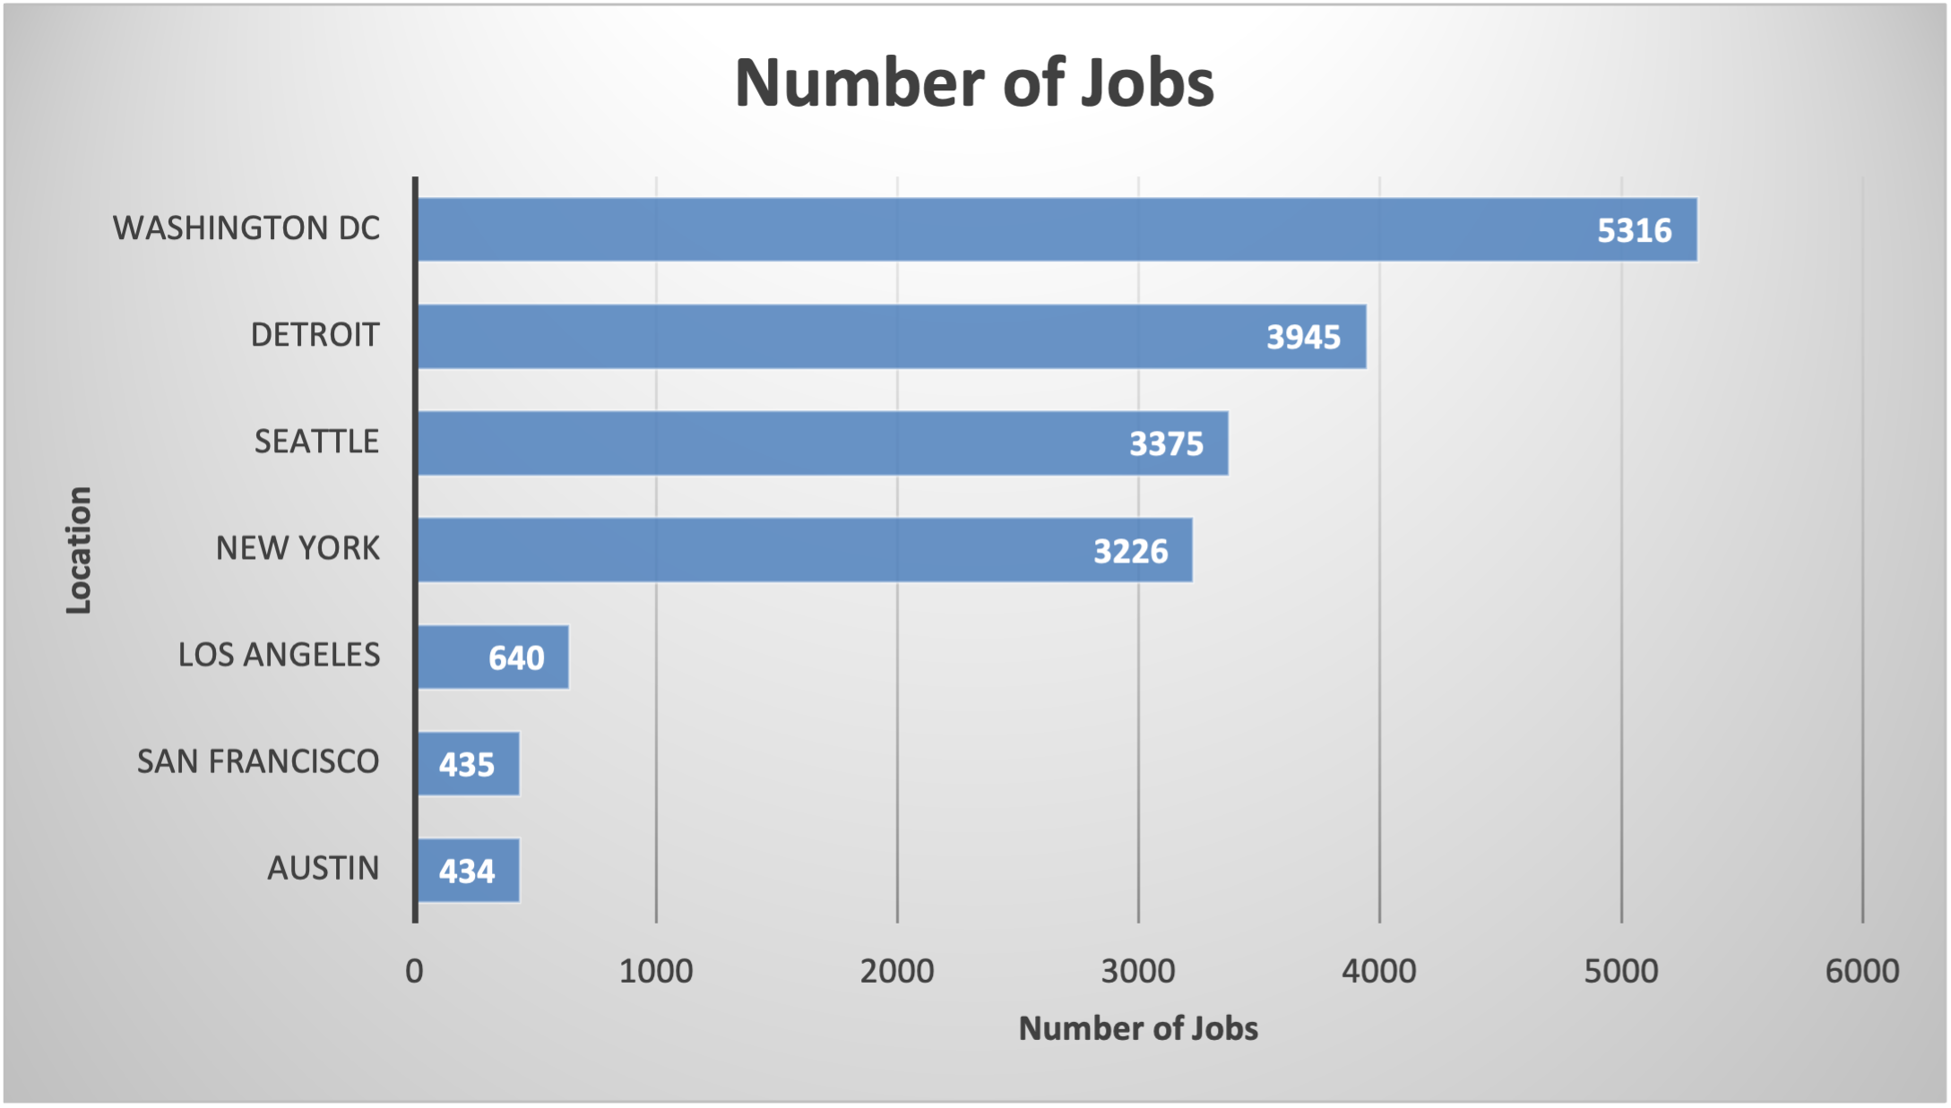
JOB POSTINGS
In Module 1 you have collected the job posting data using Job API in a file named “job-postings.xlsx”. Present that data using a bar chart here. Order the bar chart in the descending order of the number of job postings.

Slide 25
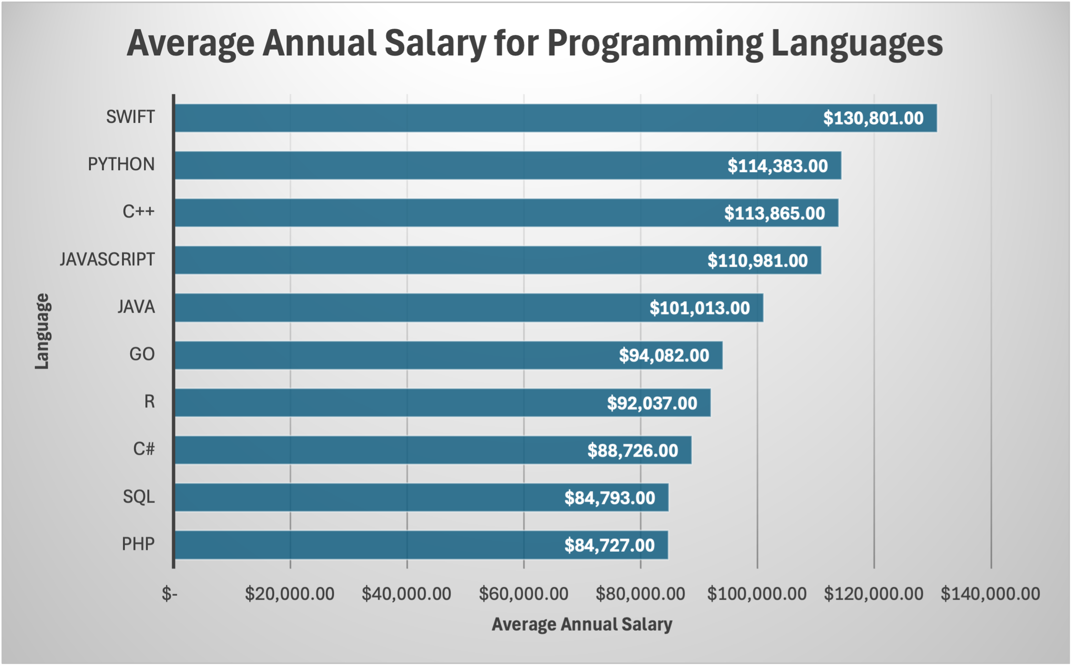
POPULAR LANGUAGES
In Module 1 you have collected the job postings data using web scraping in a file named “popular-languages.csv”. Present that data using a bar chart here. Order the bar chart in the descending order of salary.

